Slide 1
Per- and Polyfluoroalkyl Substances (PFAS)
Ben Wise
Environmental Scientist
South Platte Renew

Slide 2
overview
What is PFAS and where does it come from?
What are the regulations?
Treatment and disposal options
Next Steps

Slide 3
What is pfas?

Slide 4
What is pfas?
Ring form
Contains all the evil of the world
Followed around by seedy characters
https://www.buzzfeed.com/jarrylee/age-is-just-a-number-when-youre-an-elf

Slide 5
What is pfas?
Per- and polyfluoroalkyl substances (PFAS) are a family of 5,000+ compounds
Carbon + fluorine bond (one of the strongest chemical bonds)
In production since the 1940’s
Teflon
Food packaging (fast food wrappers, microwave popcorn, etc.)
Water repellent clothing
Domestic products (lipstick, shampoo, dental floss, etc.)
Carpeting
Ski wax
80% of exposure comes from domestic products,
20% from drinking water
Found in 99% of people’s blood
https://www.wvpublic.org/post/dupont-offers-670m-settlement-teflon-chemical-contamination-water#stream/0

Slide 6
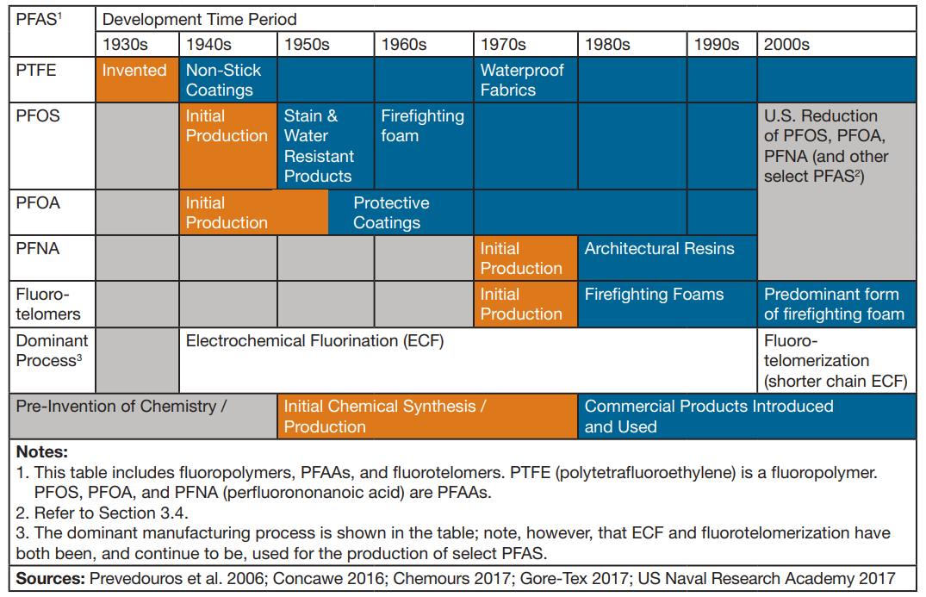
What is PFAS?
https://pfas-1.itrcweb.org/wp-content/uploads/2017/11/pfas_fact_sheet_history_and_use__11_13_17.pdf

Slide 7
Health effects
What are the health effects?
Linked to low birth weight
Increased risk of heart and liver disease and/or high blood pressure
Various cancers and thyroid hormone disruption
Causes reproductive and developmental, liver and kidney, and immunological effects in laboratory animals
“We don’t know much.”
Toxicological studies are ongoing
https://drive.google.com/file/d/14ZIzesBDhzOk-938jsxSjYAfBezKiwLd/view
https://www.epa.gov/pfas/basic-information-pfas#health

Slide 8
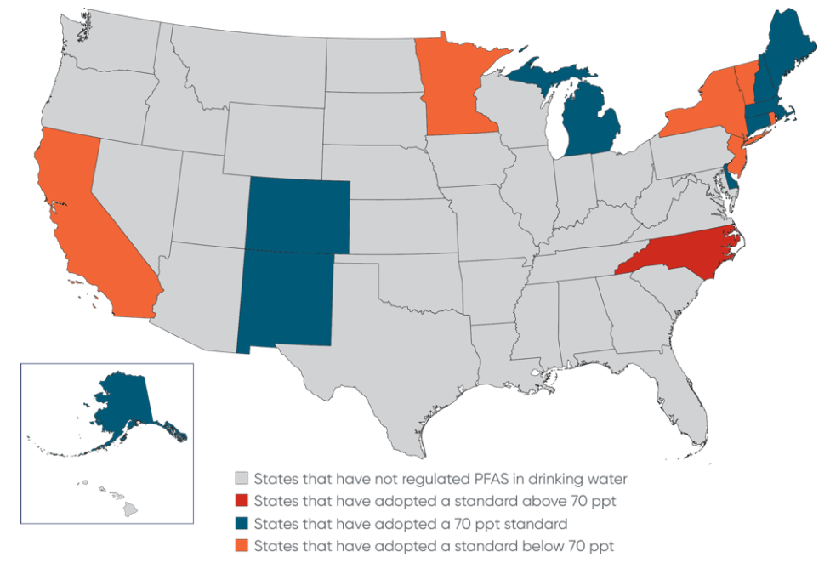
Around the country
https://www.ewg.org/news-and-analysis/2018/03/washington-first-state-ban-fluorinated-chemicals-food-packaging
https://www.jdsupra.com/legalnews/state-by-state-regulation-of-per-and-82542/
https://www.nhpr.org/post/nh-sues-makers-pfas-chemicals-drinking-water-contamination#stream/0
https://thehill.com/policy/energy-environment/480571-sanders-introduces-bill-to-clean-up-of-toxic-forever-chemicals

Slide 9
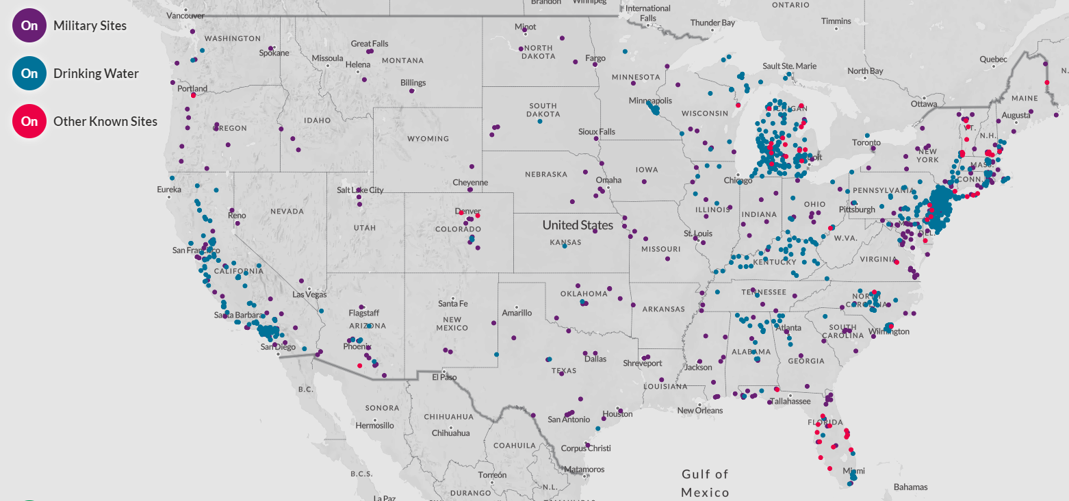
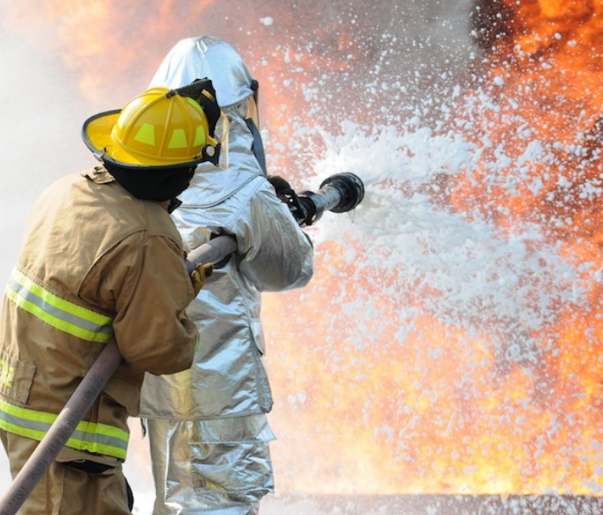
Firefighting foam
Aqueous film-forming firefighting foam (AFFF)
Military bases and firefighting training facilities
Impacted drinking water supplies around the country
https://drive.google.com/file/d/14ZIzesBDhzOk-938jsxSjYAfBezKiwLd/view
https://www.ewg.org/interactive-maps/2019_pfas_contamination/map/

Slide 10
In Colorado
What areas are affected in Colorado?
Boulder Mountain Fire Protection District: High levels at a groundwater well at one of the district’s stations.
Buckley Air Force: High levels in groundwater wells on the base. Potential off site migration being investigated. No public water systems are known to be impacted.
Fort Carson: High levels in groundwater wells on and off the base. All residents located near the base have been notified of the on base contamination and well sampling events that occurred off-base. No public water system has been impacted. Base is currently in the process of cleaning up the contamination and notifying off base impacted well owners of PFAS concentrations.
Peterson Air Force Base: High levels in groundwater wells on the base. Public water systems were impacted and are now treating for the chemical; PFAS chemical levels are below health advisory in treated drinking water. Base is currently in the process of cleaning up the contamination.
Schriever Air Force Base: High levels in groundwater wells on the base. Off base contamination has not been identified. No public water system has been impacted. Base is currently in the process of cleaning up the contamination.
South Adams County Water and Sanitation District: Levels are below health advisory in treated drinking water, but the district found higher PFAS chemical levels in some groundwater sources. The district has treatment to remove PFAS chemical and shut down sources with higher PFAS chemical levels.
Sugarloaf Volunteer Fire District: High levels in groundwater wells at one of the district’s stations. All residents located close to the station were notified.
Suncor: High levels in groundwater wells on site. All residents located near the site have been notified. No public water system has been impacted. Entity is currently in the process of cleaning up the contamination.
U.S. Air Force Academy: High levels in groundwater wells on the base. All residents located near the base have been notified. No public water system has been impacted. Base is currently in the process of cleaning up the contamination.

Slide 11
What are the regulations?

Slide 12
PFAS regulations
1940-present: PFAS used in domestic products and firefighting foam
2012: Unregulated Contaminant Monitoring Rule (UCMR) requires public drinking water systems to monitor from 2013-2015 for PFOA and PFOS.
2016: EPA releases a lifetime Health Advisory (HA) of 70 parts per trillion (ppt) for combined PFOA and PFOS
2018: Colorado Water Quality Control Commission (WQCC) adopts a site-specific groundwater quality standard of 70 ppt for combined PFOA and PFOS for a contaminated aquifer in El Paso County

Slide 13
PFAS Regulations
70 ppt is equivalent to…
Four grains of sugar in an Olympic sized swimming pool
$1.50 out of all the US currency in the world
One drop of water in railroad tank cars full of water 10 miles long
One second in 32,000 years

Slide 14
PFAS regulations
1940-present: PFAS used in domestic products and firefighting foam
2012: Unregulated Contaminant Monitoring Rule (UCMR) requires public drinking water systems to monitor from 2013-2015 for PFOA and PFOS.
2016: EPA releases a lifetime Health Advisory (HA) of 70 parts per trillion (ppt) for combined PFOA and PFOS
2018: Colorado Water Quality Control Commission (WQCC) adopts a site-specific groundwater quality standard of 70 ppt for combined PFOA and PFOS for a contaminated aquifer in El Paso County

Slide 15
PFAS regulations
Regulation 42: Site-Specific Water Quality Classifications and Standards for Groundwater
70 ppt PFOA + PFOS only for the Security-Widefield area of the state where drinking water systems served by groundwater sources are known to be contaminated
Groundwater only, not surface or drinking water

Slide 16
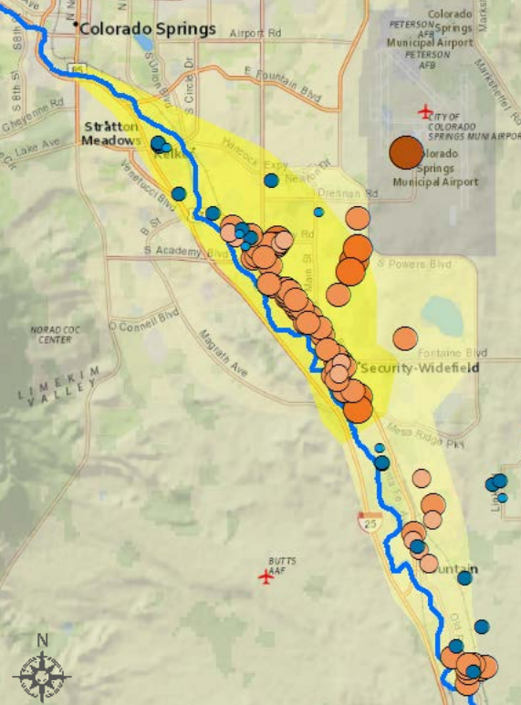
Pfas regulations
Peterson Air Base and Security-Widefield Aquifer
Years of petroleum fire drills using AFFF
After UCMR data was gathered, the Security Water District sues the U.S. Air Force
Air Force installs 1-mile pipeline to deliver drinking water from Colorado Springs Utilities ($6 million)
Colorado passes site-specific groundwater standard of 70 ppt to provide cleanup level
Air Force installs ion exchange treatment ($50+ million) and drinking water is now below detection limits

Slide 17
Pfas regulations
“outlines how we will minimize new contamination and respond to any communities where these chemicals are found at levels that could affect health.”
Risk reduction
Prioritize high risk areas
AFFF best management practices
Map and track contamination (AFFF survey)
Drinking water protection
Known or suspected areas of contamination will first have drinking water sources tested
“Identifying possible legislative changes.”

Slide 18
Pfas regulations
House Bill 19-1279: Protect Public Health Firefighter Safety Regulation PFAS Polyfluoroalkyl Substances
Restricts training with and sale of AFFF
Requires PPE manufacturers to disclose if equipment contains PFAS
Allows CDPHE to require a certificate of compliance from manufacturers of AFFF or related PPE
Allows CDPHE authority to conduct statewide survey of fire districts (20% response rate)
House Bill 20-1119: State Government Regulation of Perfluoroalkyl and Polyfluoroalkyl Substances
Created aircraft hangar AFFF registration system
Establishes registration program for any entity storing any PFAS substances and standards for capture and disposal
Creates an ‘enterprise fund’ that taxes petroleum refining and distribution operations
Requires that by 2025 CDPHE present results of statewide survey

Slide 19
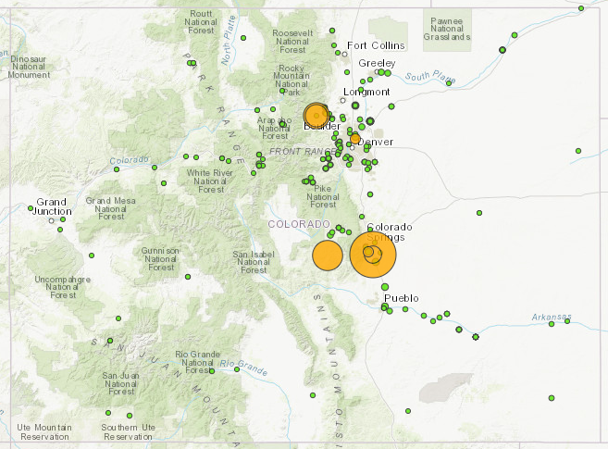
Statewide Survey

Slide 20
PFAS Regulations
Policy 20-1: Policy for Interpreting the Narrative Water Quality Standards for Per- and Polyfluoroalkyl Substances (PFAS)
Cumulative threshold of 70 ppt for specific PFAS (PFOA, PFOS, PFNA, PFHxS, PFBS) + “parent compounds”
Focus on monitoring
“permittee shall furnish to the division any information which the division may request to determine whether cause exists for modifying or revoking or reissuing the permit”
Effluent limits: 30-day and daily maximum limits a possibility
Problems: there isn’t a certified lab method, false positives are common, treatment and disposal very difficult, likelihood of majority of PFAS originating from people’s homes

Slide 21
Treatment options

Slide 22
treatment

Slide 23
treatment
Treating PFAS in water
Reverse osmosis
Fluorinated carbon chain adheres to semipermeable membrane
90-99% removal
$100+ million capital for SPWRP
Creates a concentrated waste stream
Ion exchange
Fluorinated carbon chain adsorbs to media
90-99% removal
Peterson Air Base spent $50+ million for 1.7 MGD treatment system
Creates a concentrated waste stream
Granular activated carbon (GAC)
Fluorinated carbon chain adheres to surface of granular media
89-98% removal
Creates a concentrated waste stream
https://pfas-1.itrcweb.org/wp-content/uploads/2018/03/pfas_fact_sheet_remediation_3_15_18.pdf
https://www.colorado.gov/pacific/cdphe/PFCs/PFAS-Narrative-Policy-Work-Group

Slide 24
treatment
Treating PFAS in water
Reverse osmosis
Fluorinated carbon chain adheres to semipermeable membrane
90-99% removal
$100+ million capital for SPWRP
Creates a concentrated waste stream
Ion exchange
Fluorinated carbon chain adsorbs to media
90-99% removal
Peterson Air Base spent $50+ million for 1.7 MGD treatment system
Creates a concentrated waste stream
Granular activated carbon (GAC)
Fluorinated carbon chain adheres to surface of granular media
89-98% removal
Creates a concentrated waste stream
https://pfas-1.itrcweb.org/wp-content/uploads/2018/03/pfas_fact_sheet_remediation_3_15_18.pdf
https://www.colorado.gov/pacific/cdphe/PFCs/PFAS-Narrative-Policy-Work-Group

Slide 25
treatment
Disposal options
Haul it to a landfill
No landfills in Colorado will take PFAS
What about landfill leachate?
Burn it
900ºC (1652ºF) for 30 minutes results in 99.9% destruction
Very energy intensive
PFAS may become more bioavailable via inhalation
https://pfas-1.itrcweb.org/wp-content/uploads/2018/03/pfas_fact_sheet_remediation_3_15_18.pdf

Slide 26
Next steps

Slide 27
sampling
Pretty darn tough.
24-hour composite, can’t use an autosampler
Avoid PFAS-containing material (shampoo, sunscreen, deodorant, water-resistant clothing, laundry detergent, fast food wrappers, etc.)
Detailed sampling plan
Expensive ($300 per sample + overnight shipping)
False positives guaranteed.

Slide 28
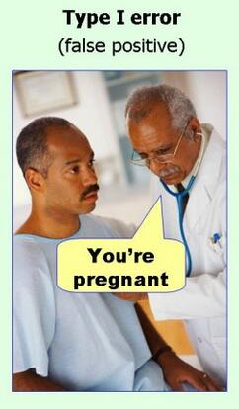
sampling
Pretty darn tough.
24-hour composite, can’t use an autosampler
Avoid PFAS-containing material (shampoo, sunscreen, deodorant, water-resistant clothing, laundry detergent, fast food wrappers, etc.)
Detailed sampling plan
Expensive ($300 per sample + overnight shipping)
False positives guaranteed.

Slide 29
Monitoring and beyond
Near term: monitoring and source investigation
CDPHE: We will be reliant on WWTP monitoring and source identification efforts to understand extent of the problem
Long term: source control and permit limits?
Public education is public protection

Slide 30
Resources
CDPHE: https://www.colorado.gov/pacific/cdphe/pfcs
EPA: https://www.epa.gov/pfas
PFAS Infographic: https://www.epa.gov/sites/production/files/2018-03/documents/pfasv15_2pg_0.pdf
Sampling guidance: https://www.michigan.gov/pfasresponse/0,9038,7-365-88059_91297---,00.html

Slide 31
Questions?
Ben Wise
bwise@englewoodco.gov

